Slide 1

Made from Taiwanese…

Slide 2
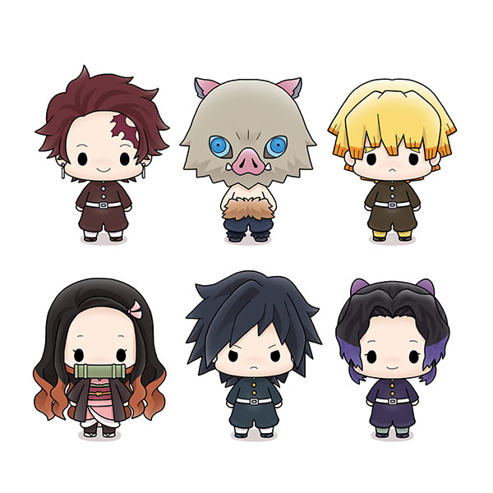

Anime
(アニメ)

Slide 3
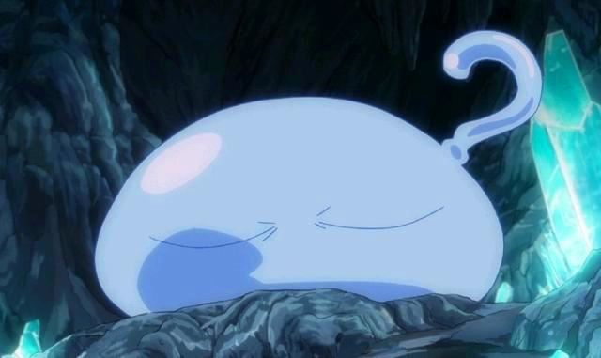
What is “anime”

Slide 4

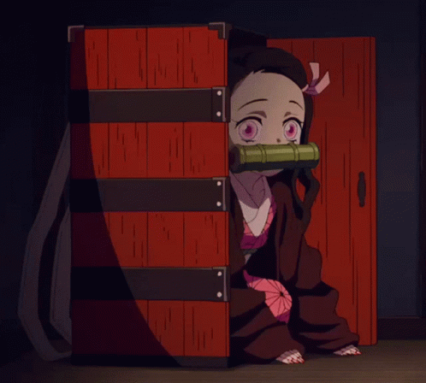
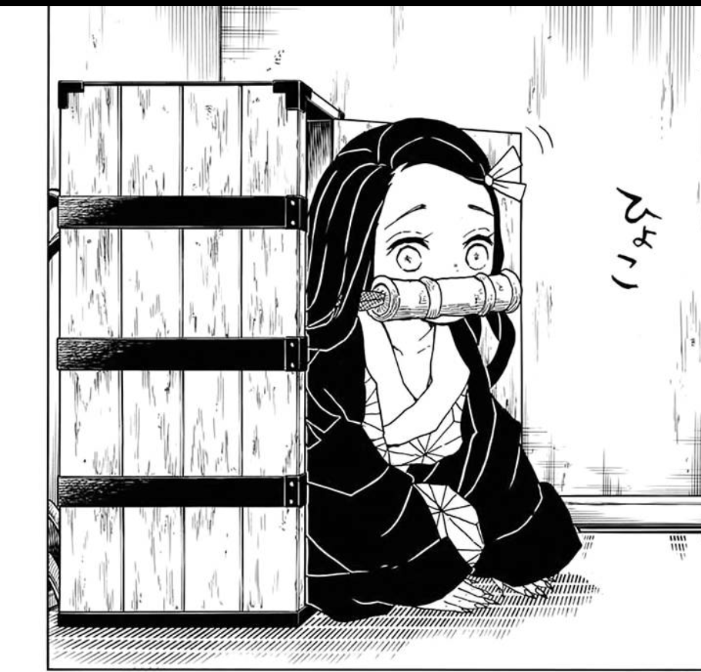
anime
Animation
comic

Slide 5
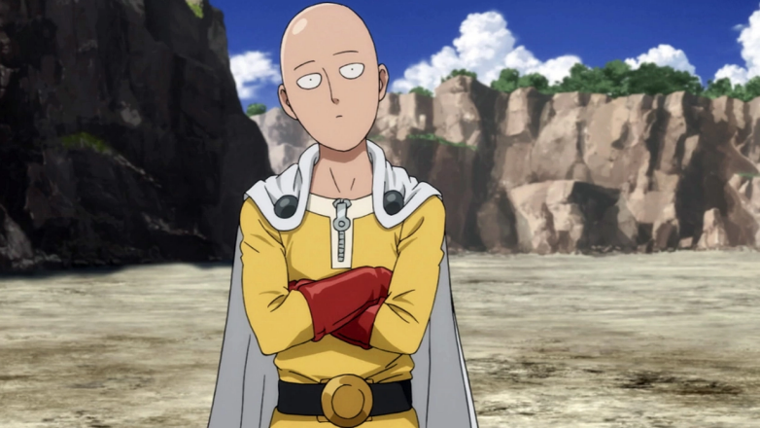
The type of the anime

Slide 6
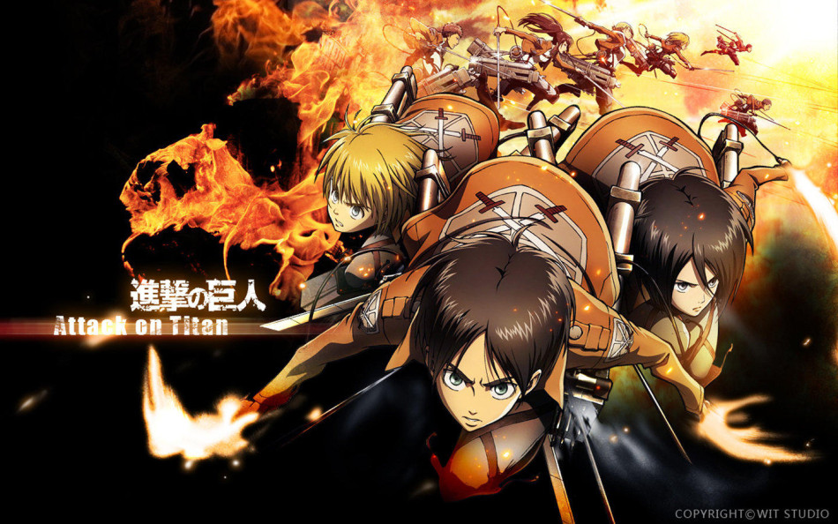
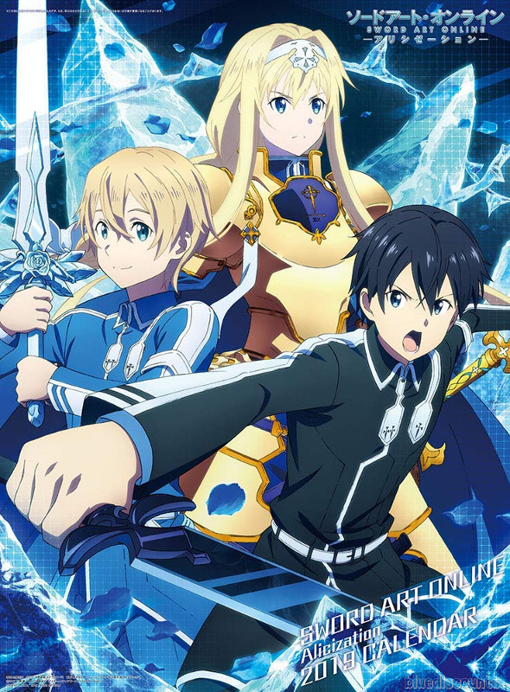
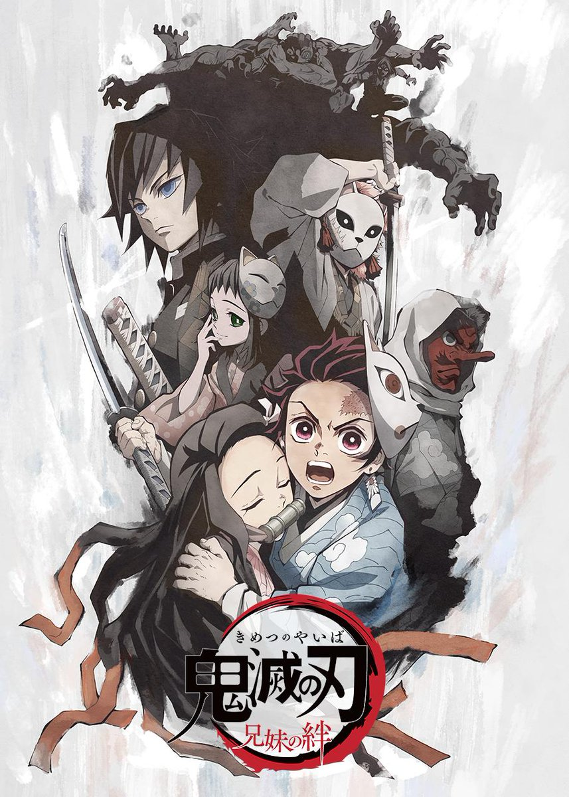
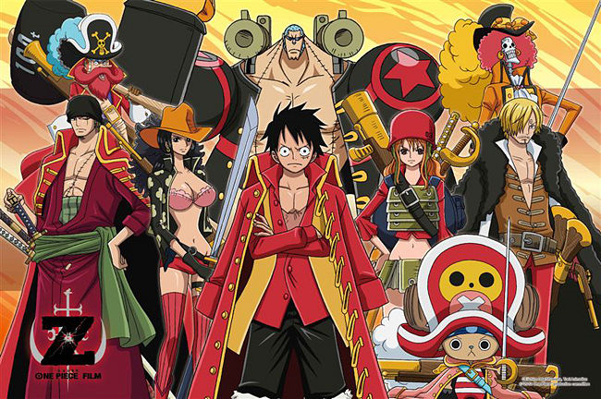
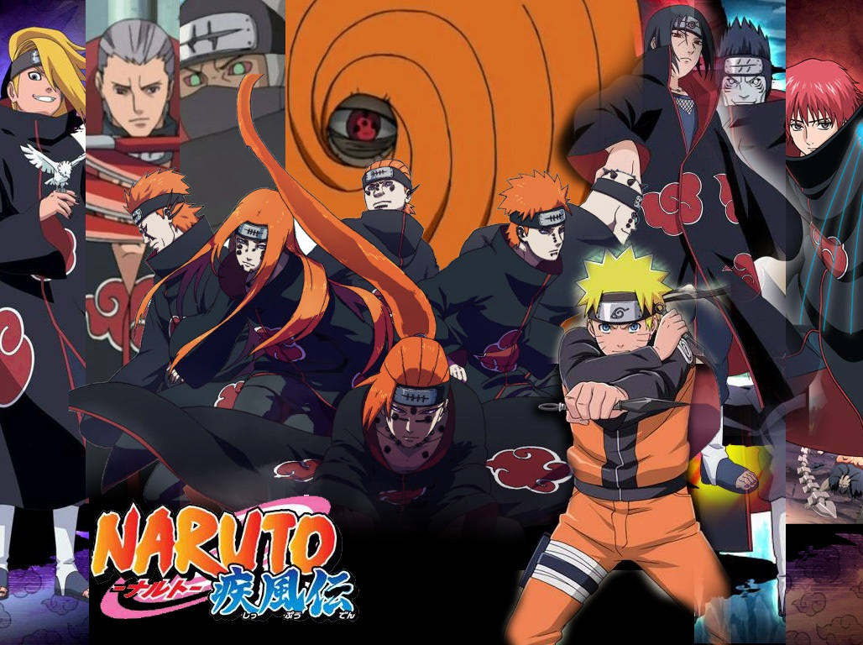
Some anime about…
hot blood
fetters
Famous on the world

Slide 7


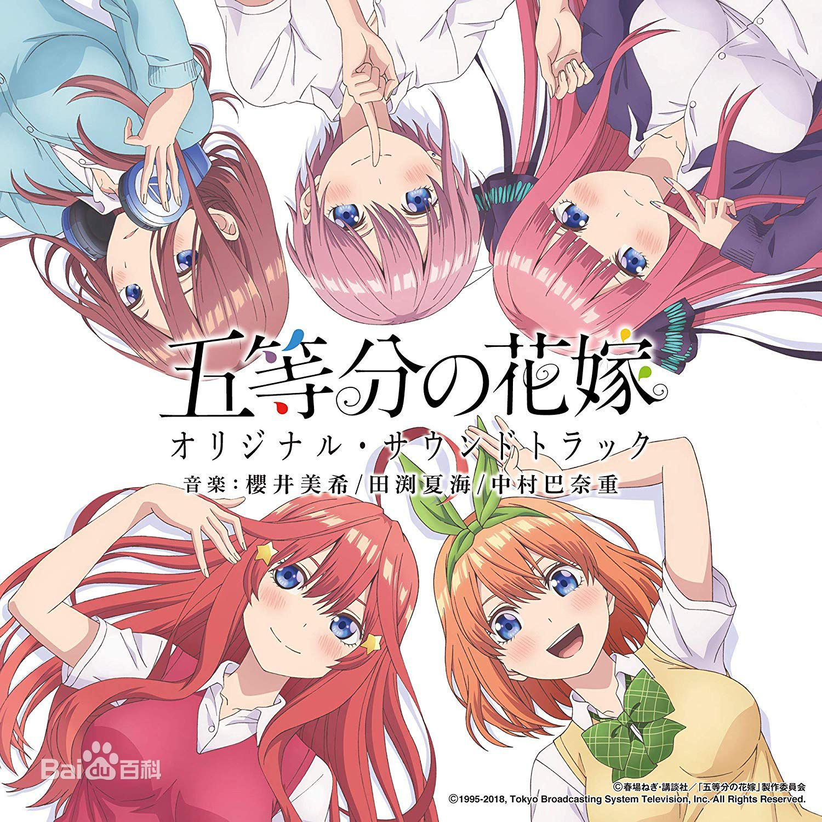
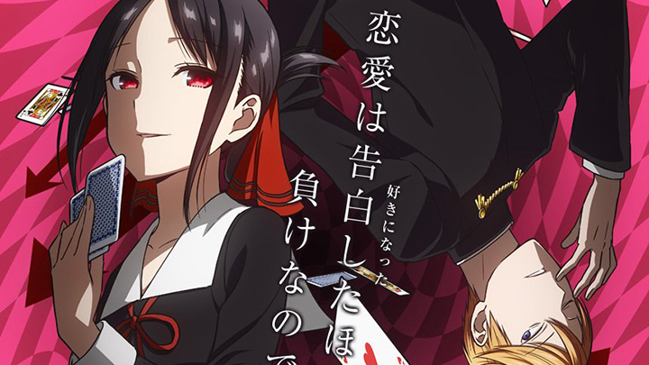
Some anime about…
love
romance
school live

Slide 8
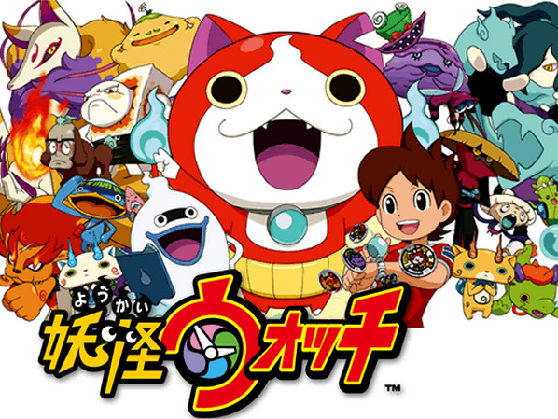
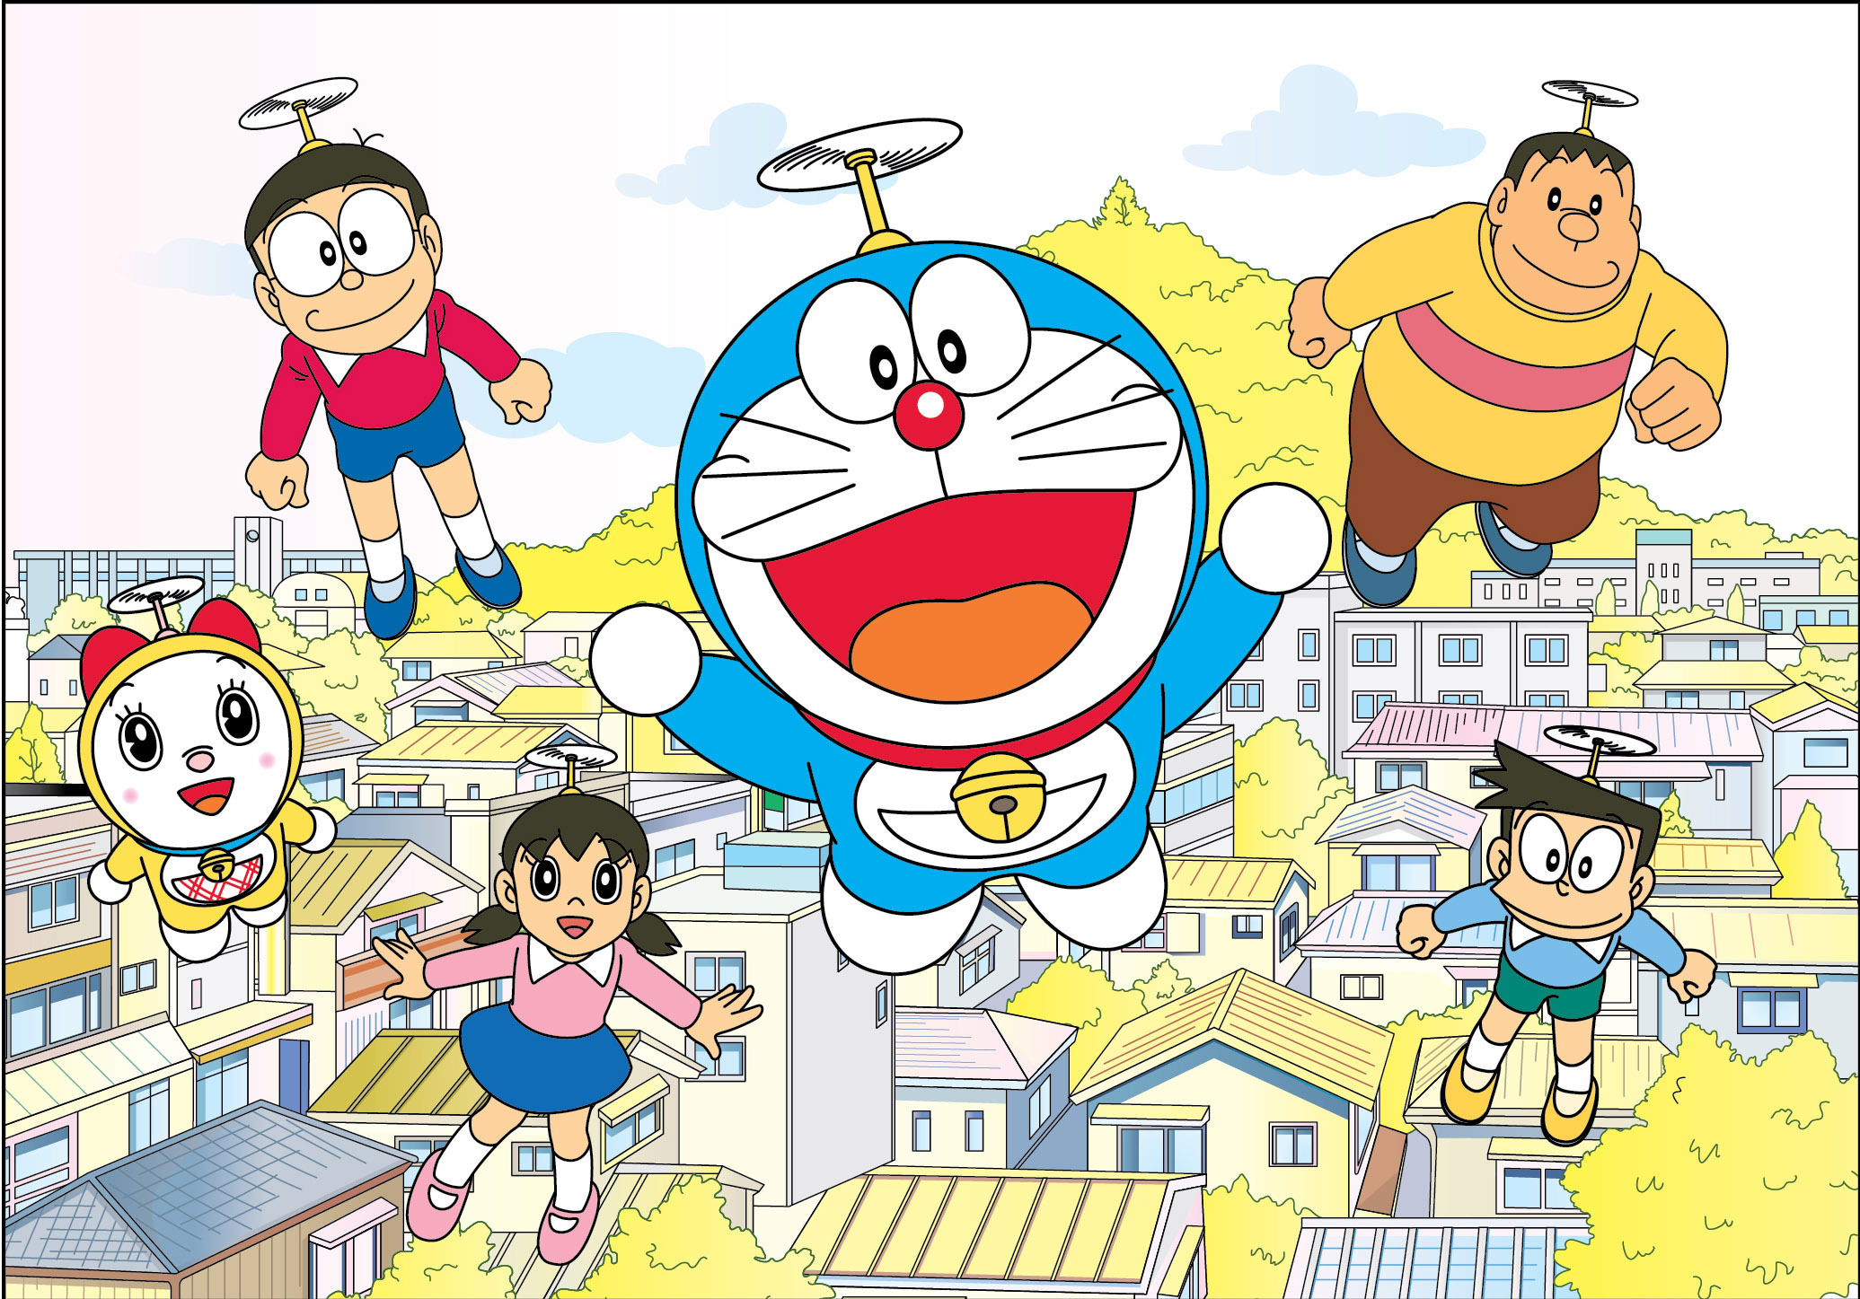
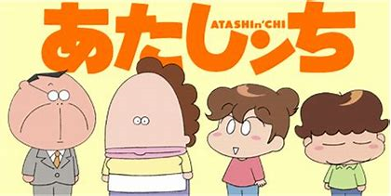
Some anime about…
childhood memory

Slide 9
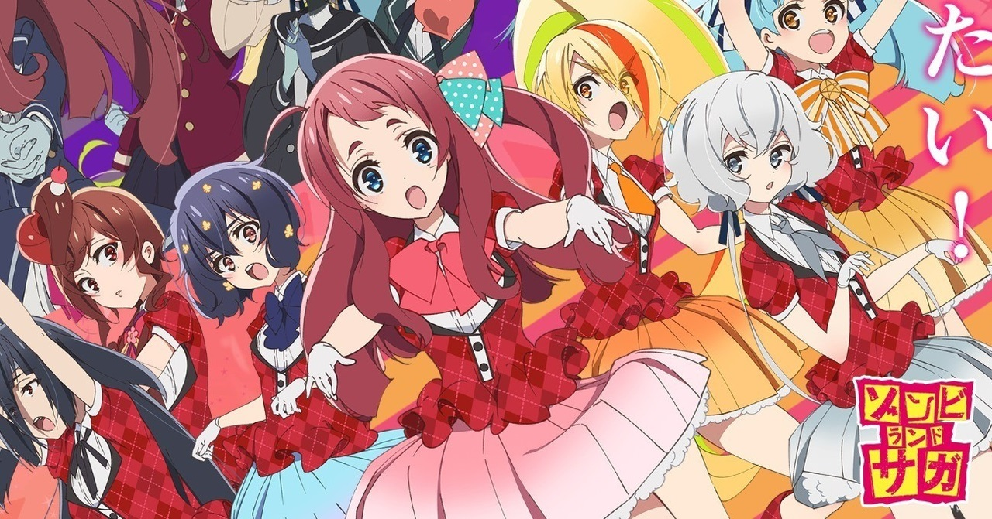
ゾンビランドサガ
In Japan
さがし
(佐賀偶像是傳奇)

Slide 10
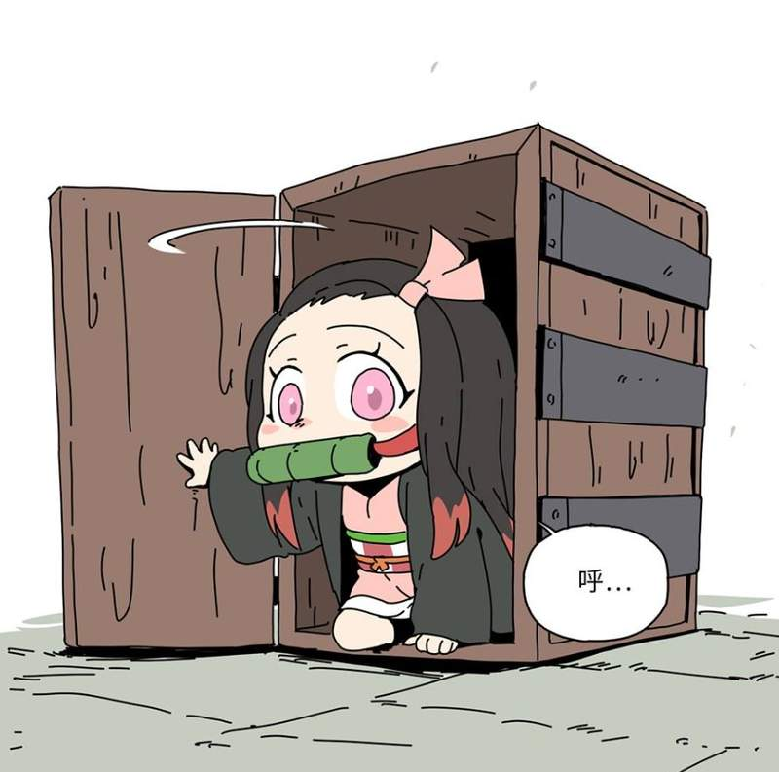
The anime character in Taiwan~!!

Slide 11

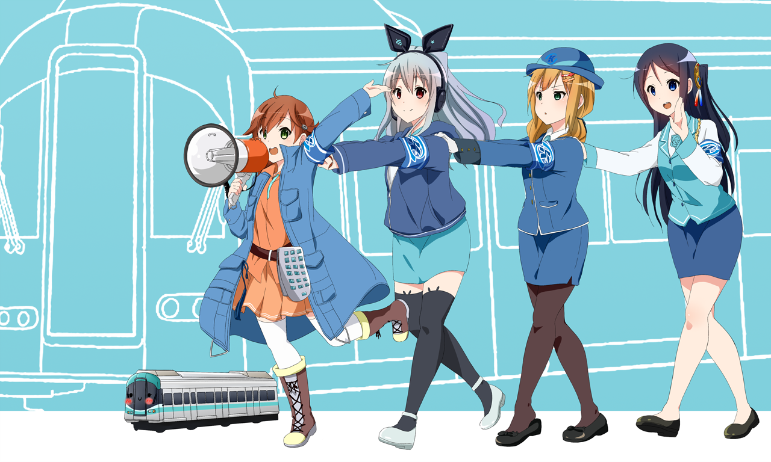
In Taiwan
たかめ少女(K.R.T.GIRLS)

Slide 12

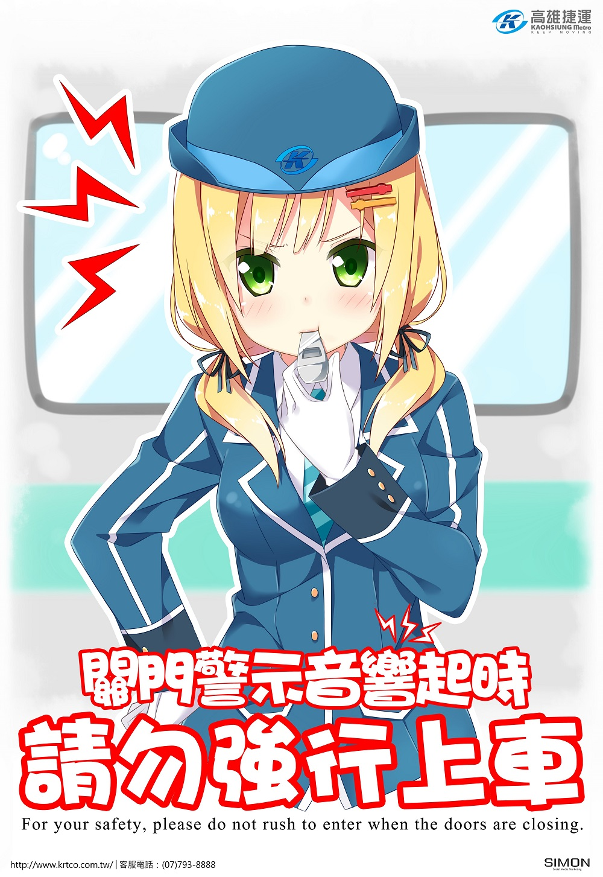
By the government in our country

Slide 13
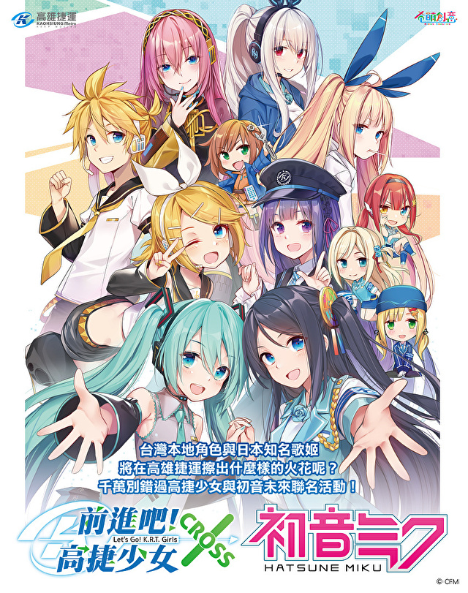
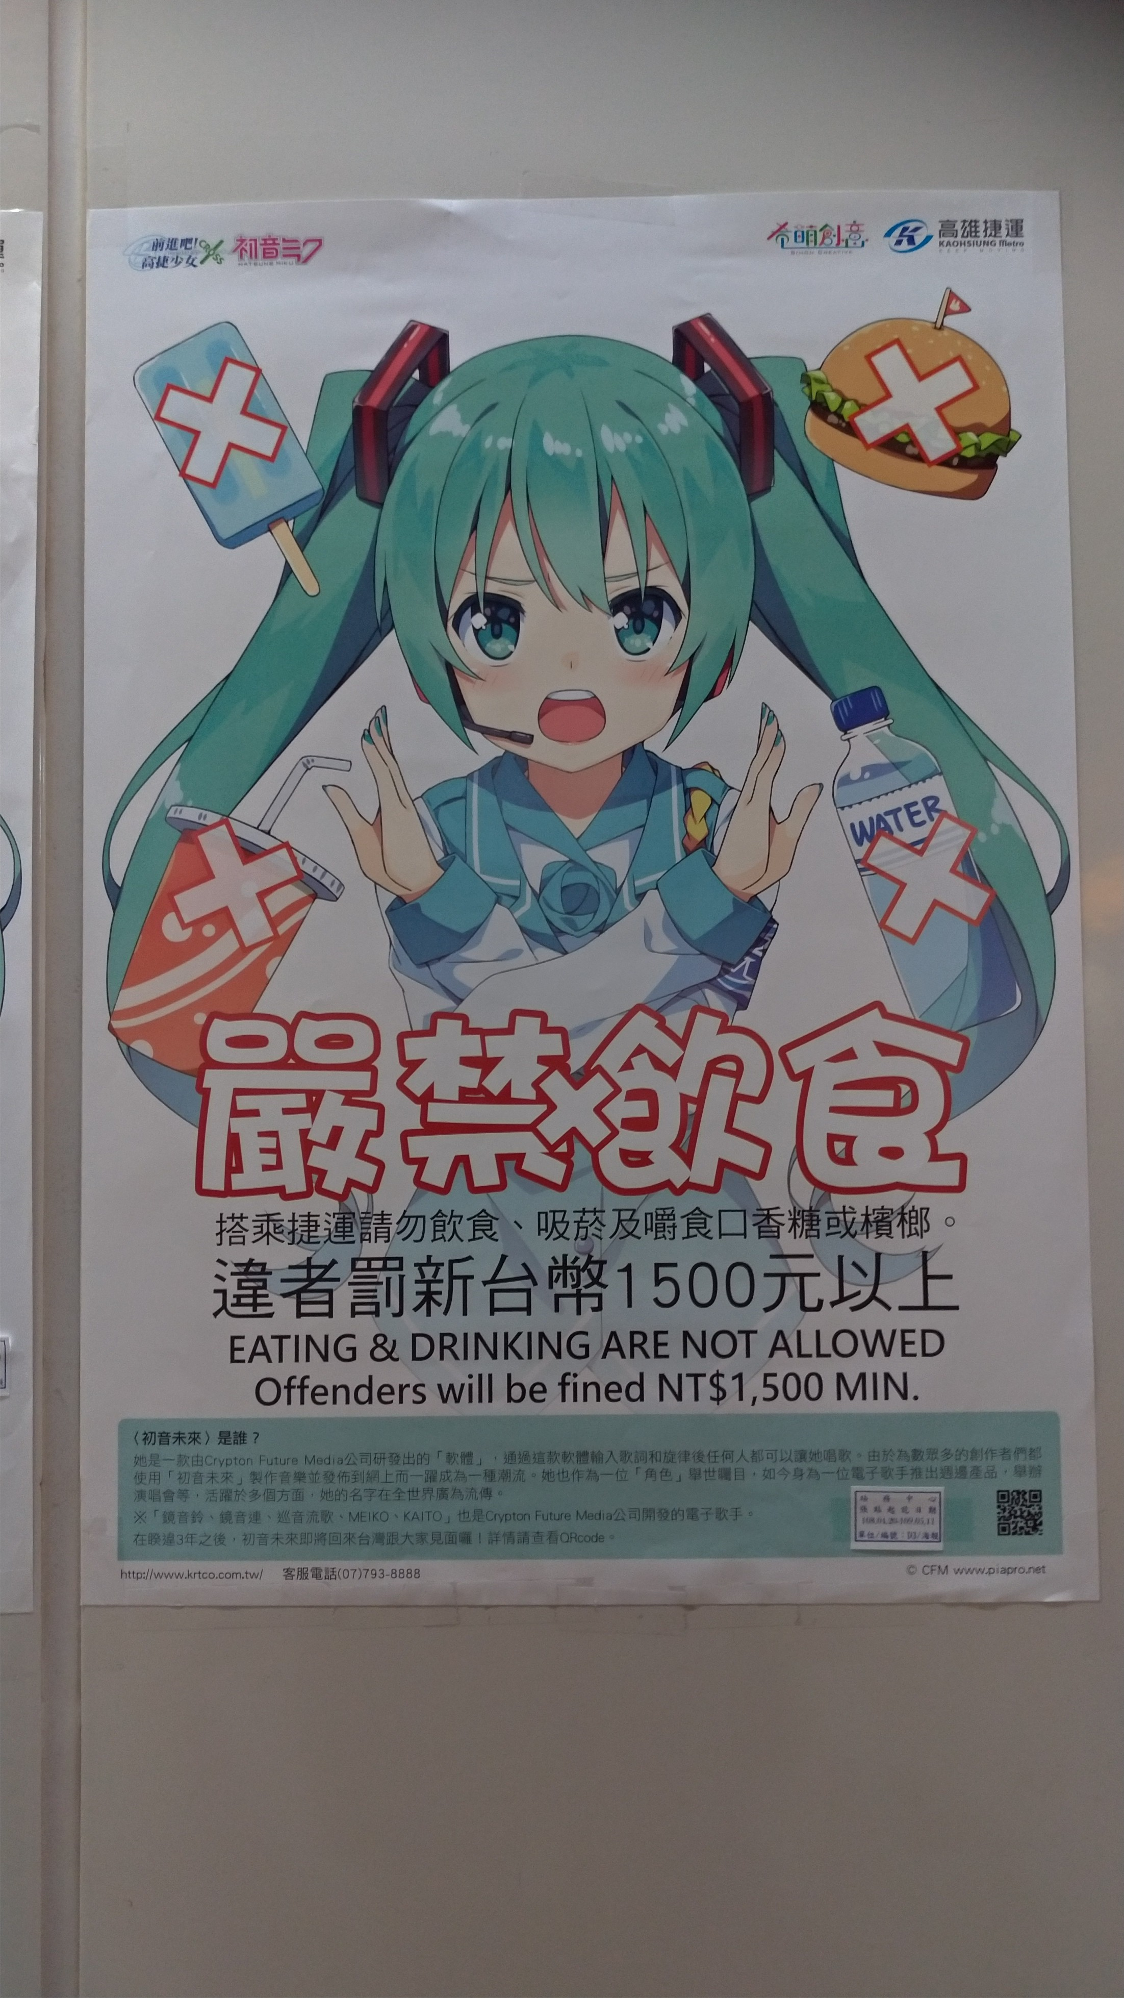

Slide 14
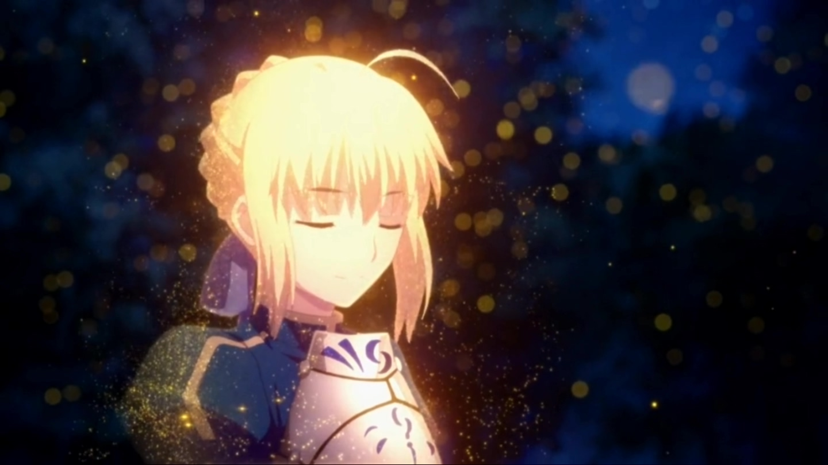
WHETHER IT IS JAPAN,TAIWAN OR OTHER COUNTRIES,
ANIME HAS BECOME AN INDISPENSABLE GREEN ISLAND IN THE HEARTS OF MANY PEOPLE.

Slide 15

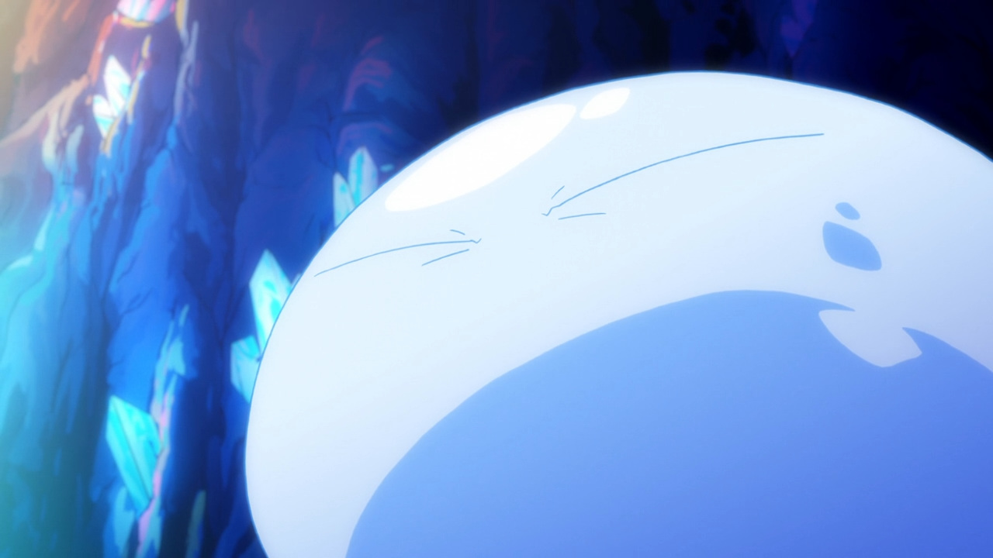
Thanks for listening (聞いてくれてありがとう)

